Slide 1
ME 4501 Vibrations and Control Lab
Dr. Ayse TEKES

Slide 2
SDOF Vibrations
Learning Objectives
To measure the natural frequency of several one-degree-of-freedom (DOF) vibration systems using simple experiments and comparing with theory.
Understand how changing mass or spring constant/stiffness affects the natural frequency.
To calculate the spring constants from theory using Machine Design equations and compare with given values.
To obtain the key properties of a single-degree-of-freedom (SOF or 1DOF) freely vibrating system using experiments and theory
To experimentally determine the damping coefficient and damping ratio of a SDOF system.

Slide 3
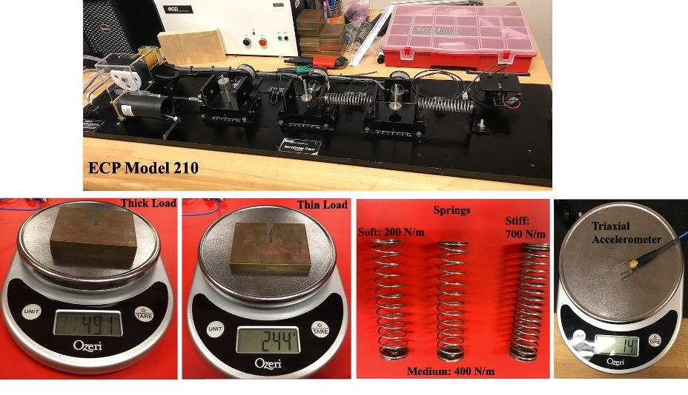
Equipment

Slide 4
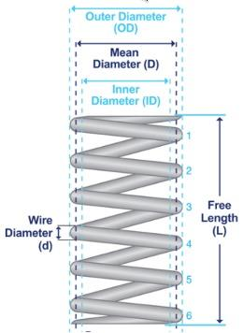
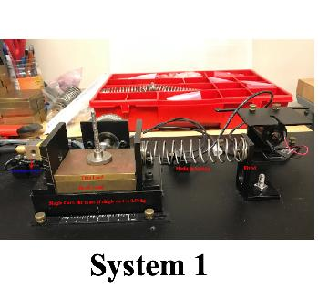

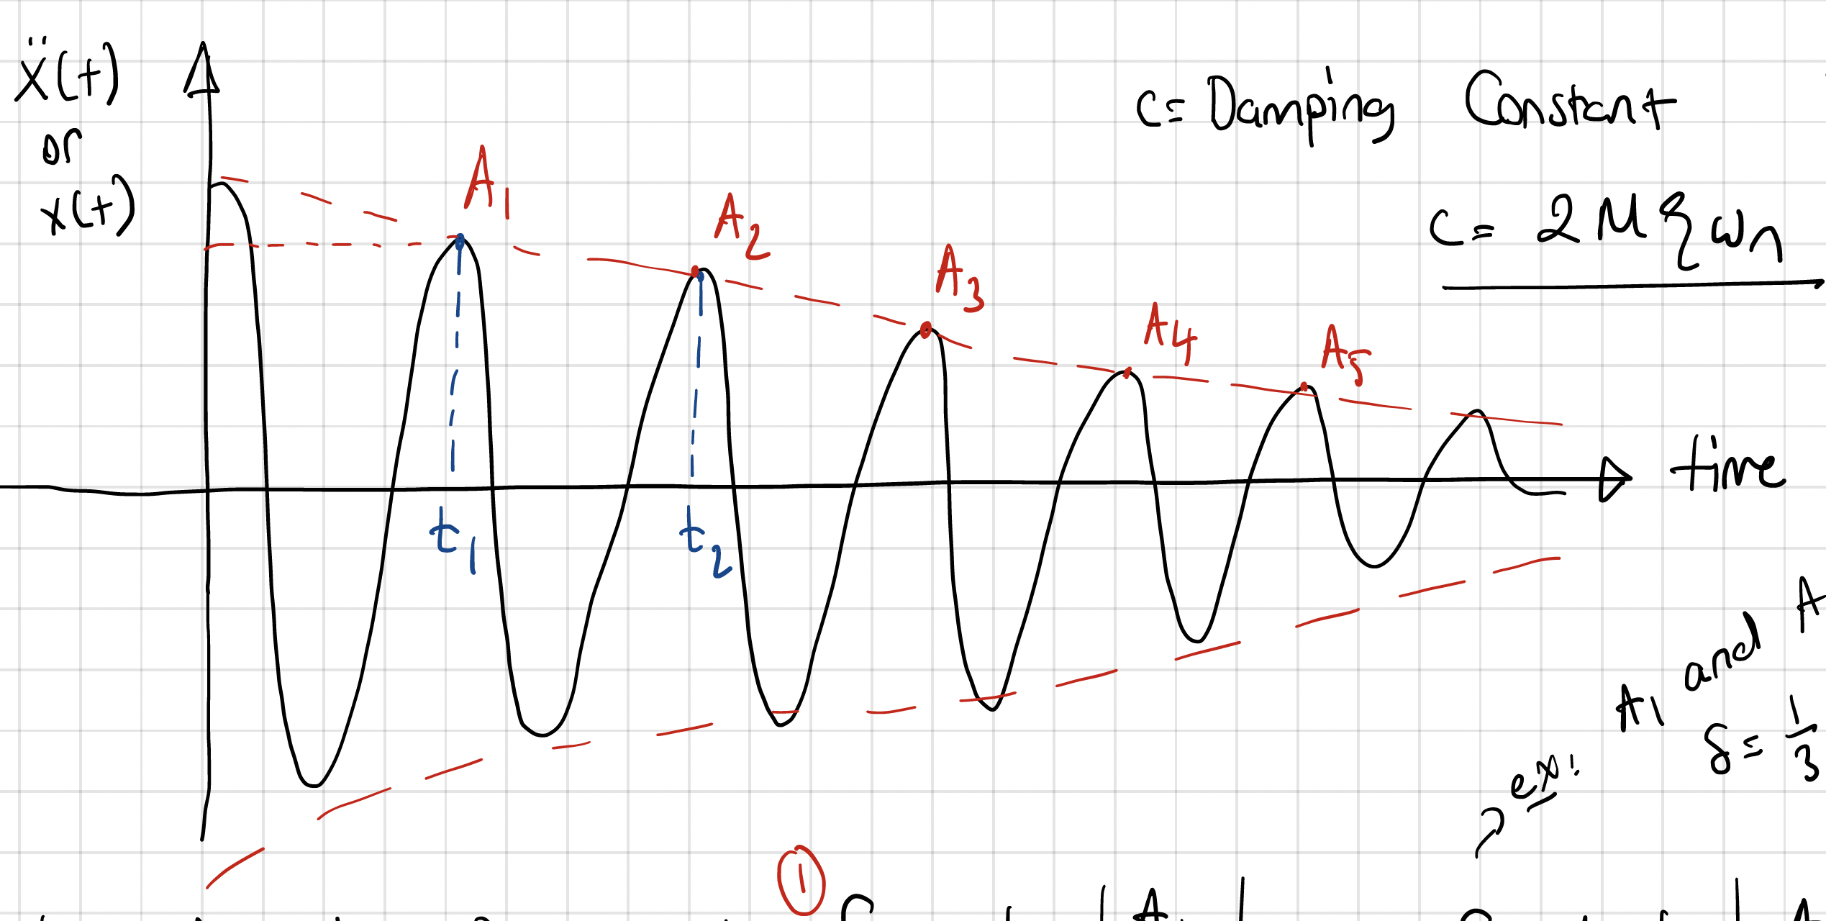
Procedures
Spring Constant Calculations
Data Collection from ECP Model 201
Calculation of Natural Frequency
System Identification Using Experimental Data and Logarithmic Decrement Method

Slide 5
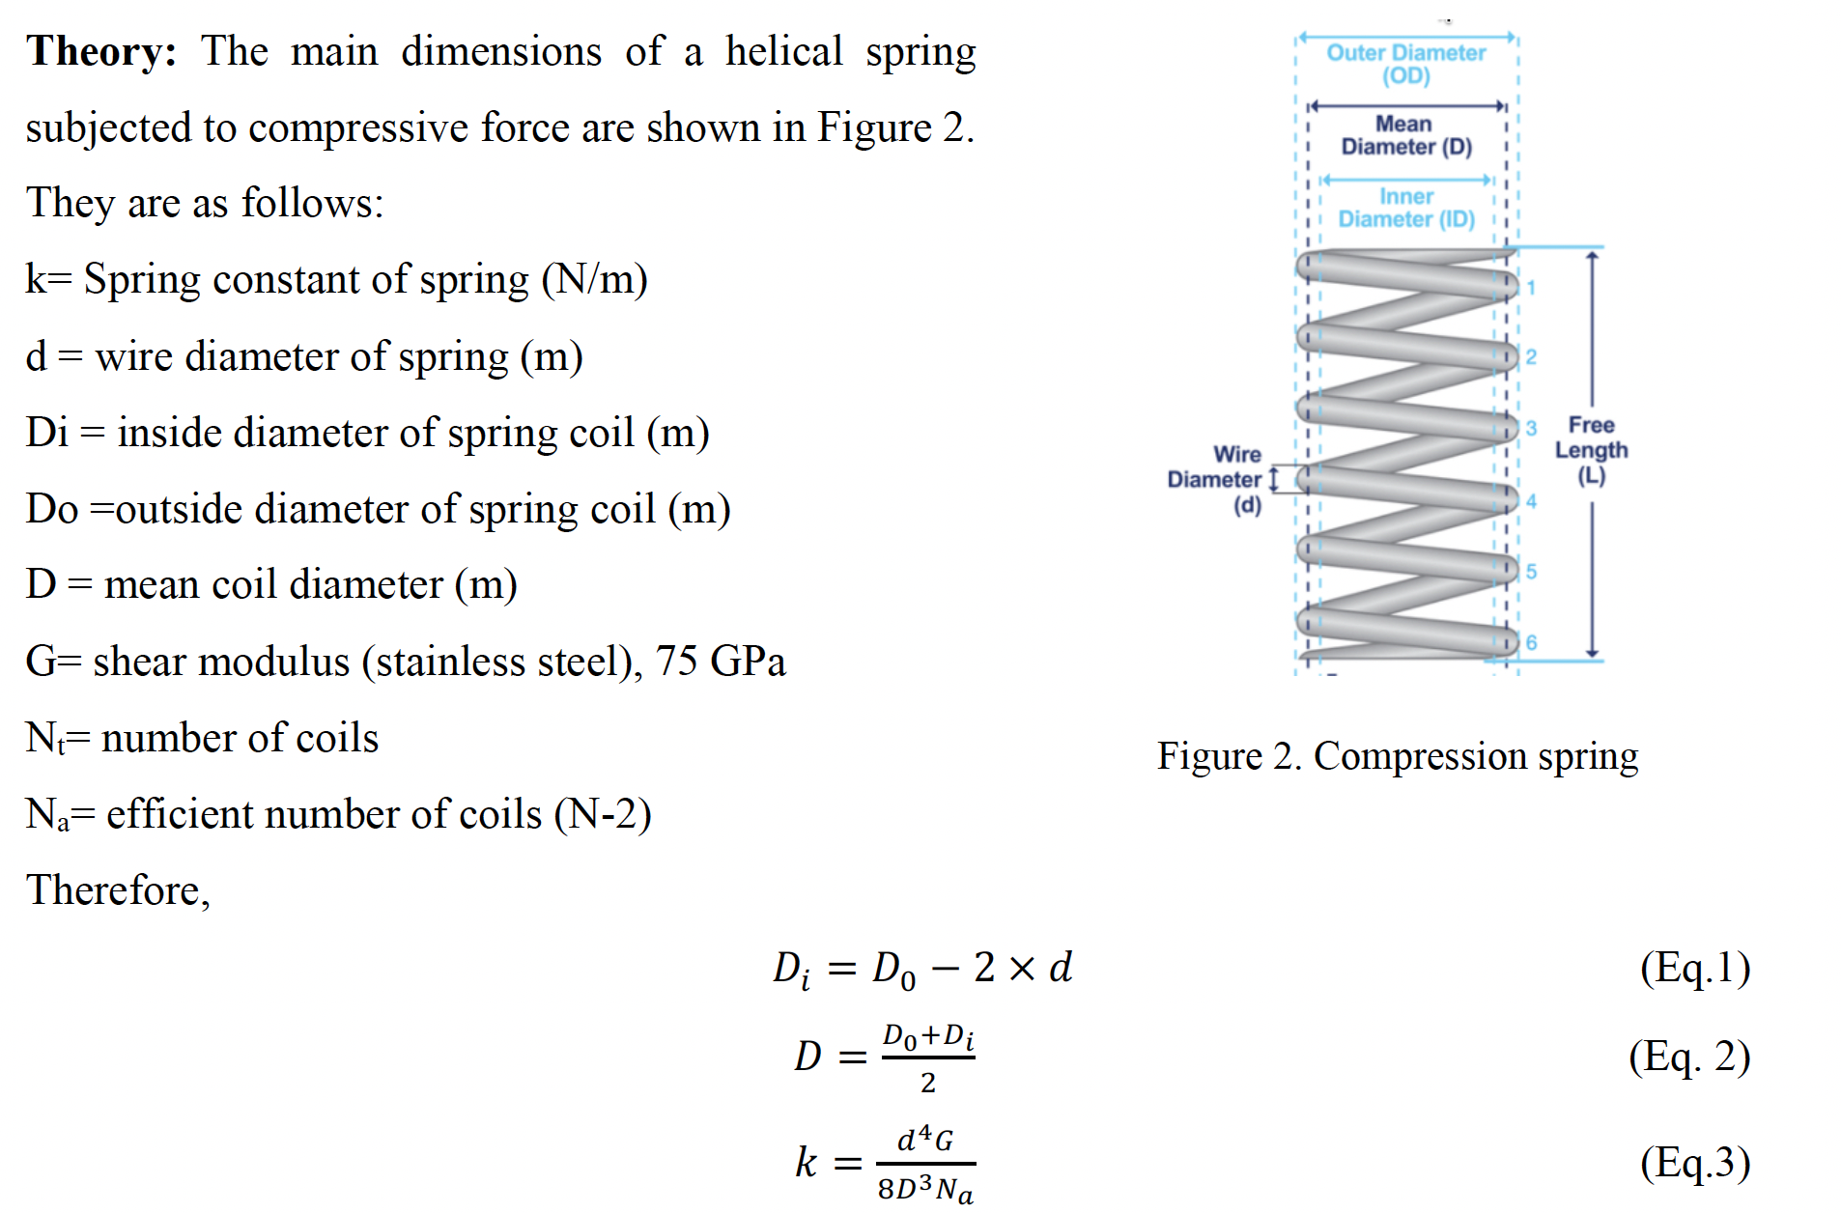
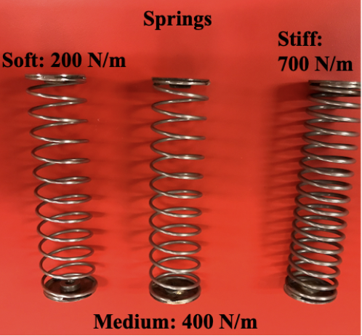
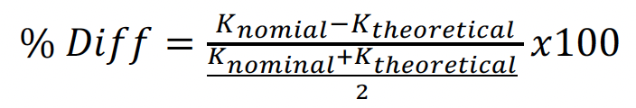
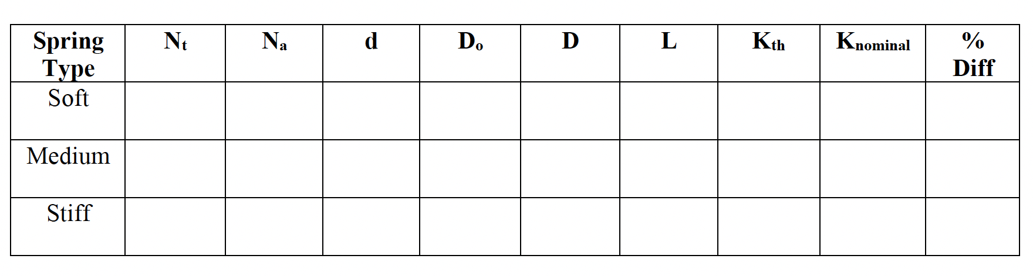
Spring Calculations

Slide 6
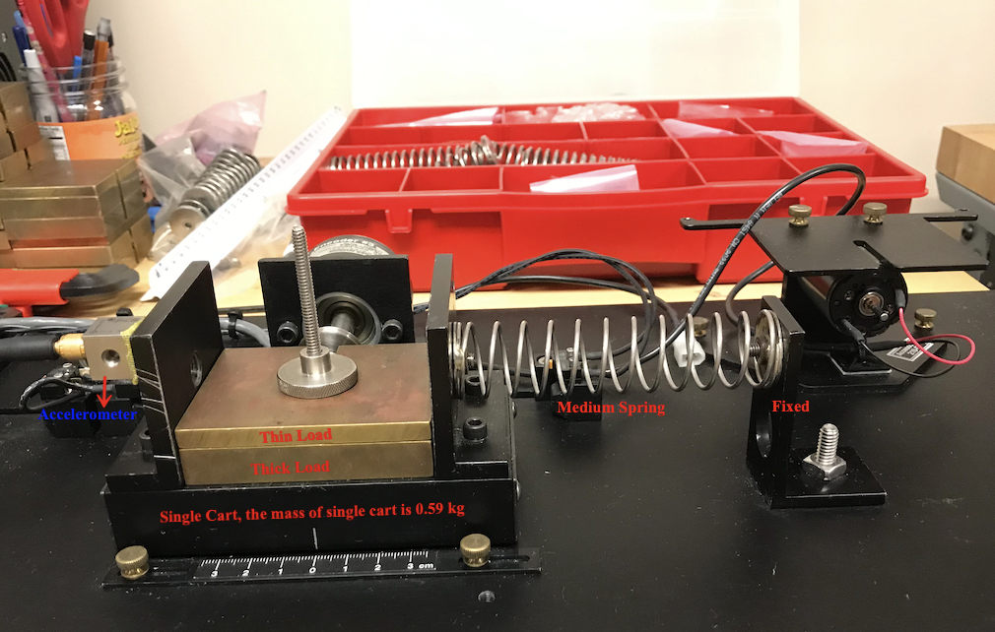
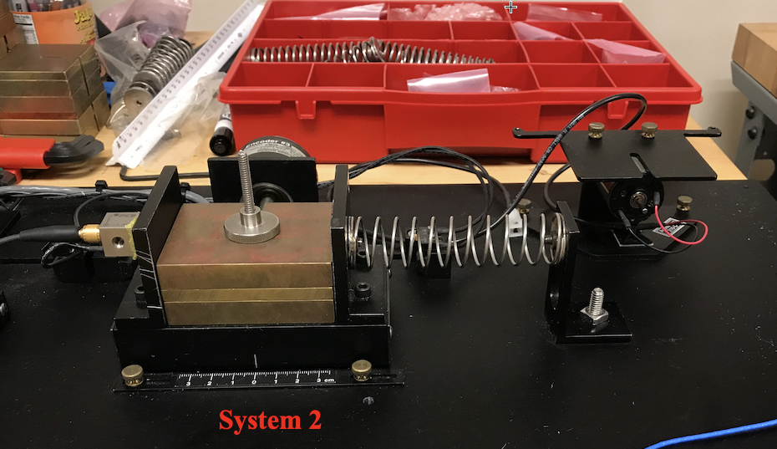
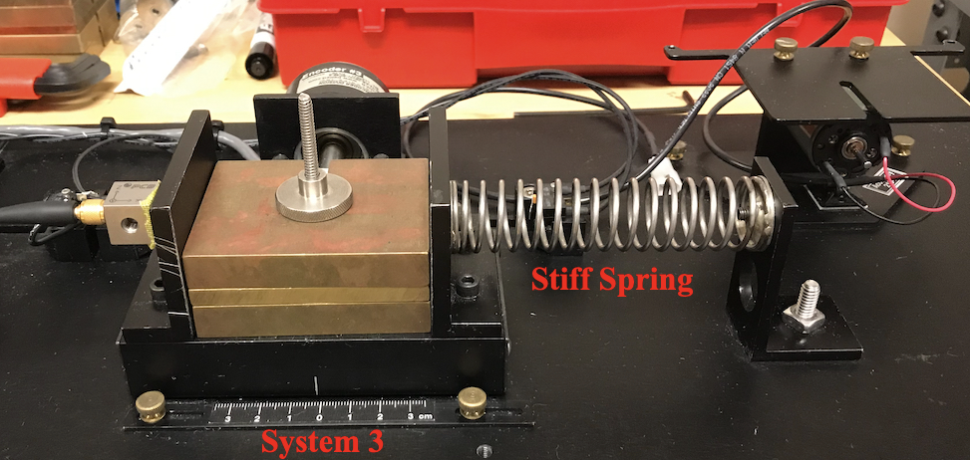
Data Collection
Change only the MASS
Change only the STIFFNESS wrt System 1
Record FREE Acceleration Data Using either 3-Axial or Uni-Axial Accelerometers, NI DAQ and NI Signal Express!

Slide 7
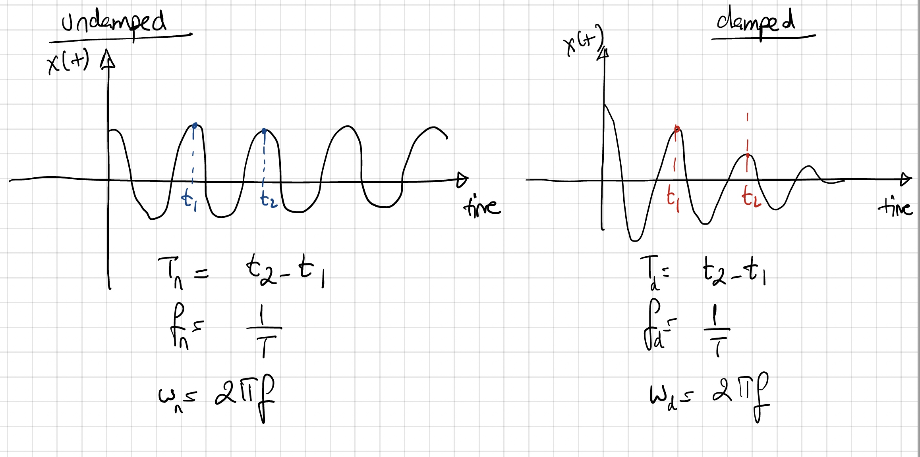
Calculation of Natural Frequency
Theoretically
&
Experimentally

Slide 8
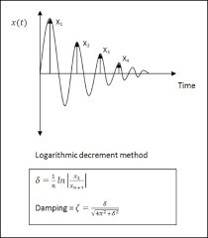
System Identification

